Slide 1
Mommy, Help My Laundry!
Mid Presentation
Team 8
Notes:
Hello, we are team 8.
My name is Inhwi hwang.
This is 민지 and this is 진용.
Our project title is “mommy, help my laundry!”
But, we thought it is too long to remember so we changed it.
Out app name is…

Slide 2

Mommy, Help My Laundry!
Mid Presentation
Team 8
Notes:
Momdry!
We also made the logo.
Now let’s get started

Slide 3
01
Refined project idea
02
Use cases & Key functions
CONTENTS
03
System architecture overview
04
Key technical challenges
& Solutions
05
Project schedule
06
Final deliverable and success criteria

Slide 4
01
Refined Project Idea

Slide 5
Refined Project Idea
Target users:
live alone
have no idea how to do laundry.
Main Problems
Many things to consider when we do laundry
dry clean, hand wash, bleach
Care labels are confusing
Too many types and variants
What about making app that give us washing tips for our clothes (by saving information of care labels)?!
Notes:
We refined our project idea.
The target users are people who live alone and have no idea how to do laundry.
For these people,
There are too many things to consider to do laundry such as dry clean, hand wash and bleach.
But, the guidance for laundry, care labels are too confusing.
So our app gives them the washing tips.

Slide 6
02
Use Cases
&
Key Functions

Slide 7
Use Cases
People who do not know about care labels
The app provides laundry tips for them
Labels on clothes washed away after using the app one or more times.
The app saves and recover laundry tips for users’ clothes
Notes:
There are two main use cases.
One is for the first user who do not know about care labels.
The app guides how to wash their clothes.
The other use case is for the people who used this app at least once.
The app saved the pair of their clothes information and laundry guidance.
They do not need to take pictures of their clothes again.
The app just recover the previous guidance about the selected clothes by the users.
Even if care labels are washed away, users can get guidances from the app.

Slide 8
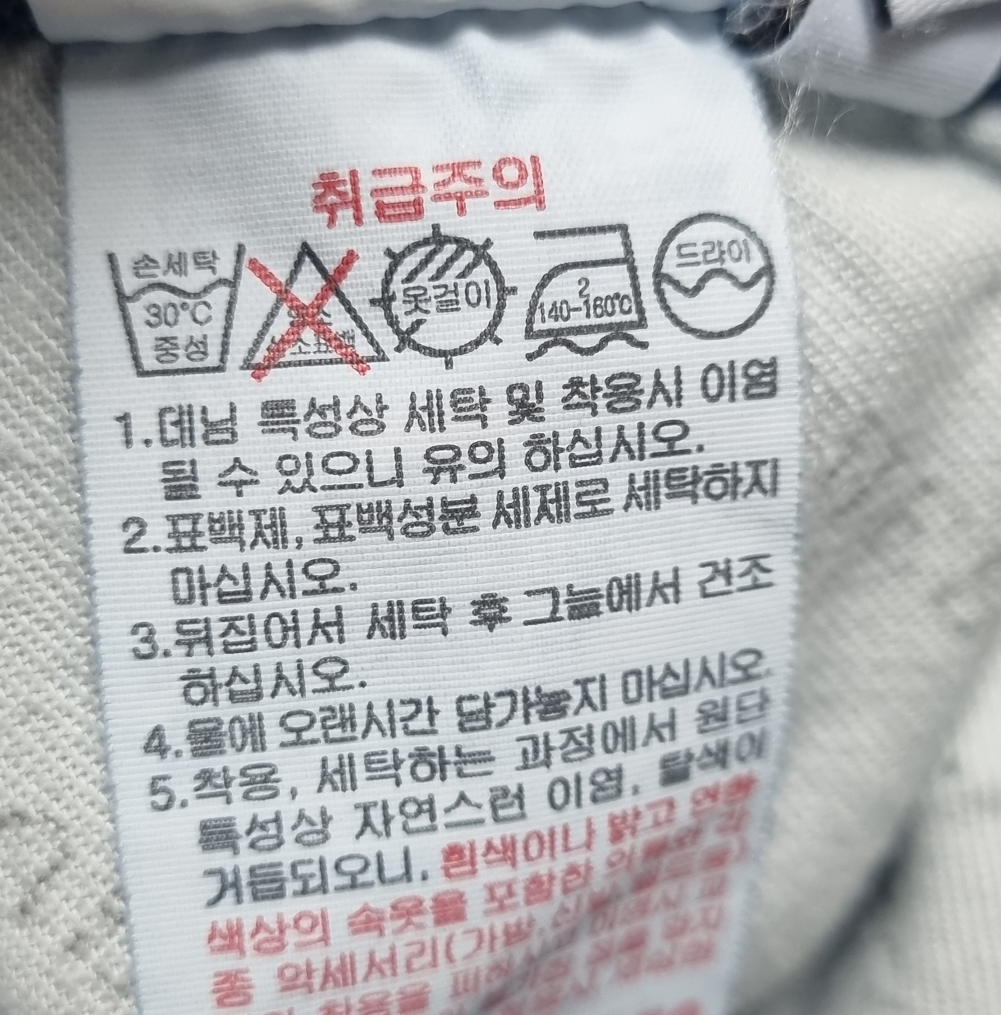



Key Functions
Recognize care labels using camera and object detection model
Guide 1: Do not use water
Guide 2: Do not use bleach …
Guide 3: Can use iron …
Guide 4: Must be dry-cleaned …
Guide 5: Dry under shade …
Take a picture of clothes and their care labels.
By using object detection model, detect washing symbols in care label.
Bring wash information from database related to the washing symbols.
Notes:
We focused to implement the key function for the first use case until now.
We trained object detection model to recognize care labels.
In the app, the user take a picture of a care label.
Then, the object detection model detect washing symbols in care label.
Finally, it brings the washing guidances from DB related to the symbols.

Slide 9
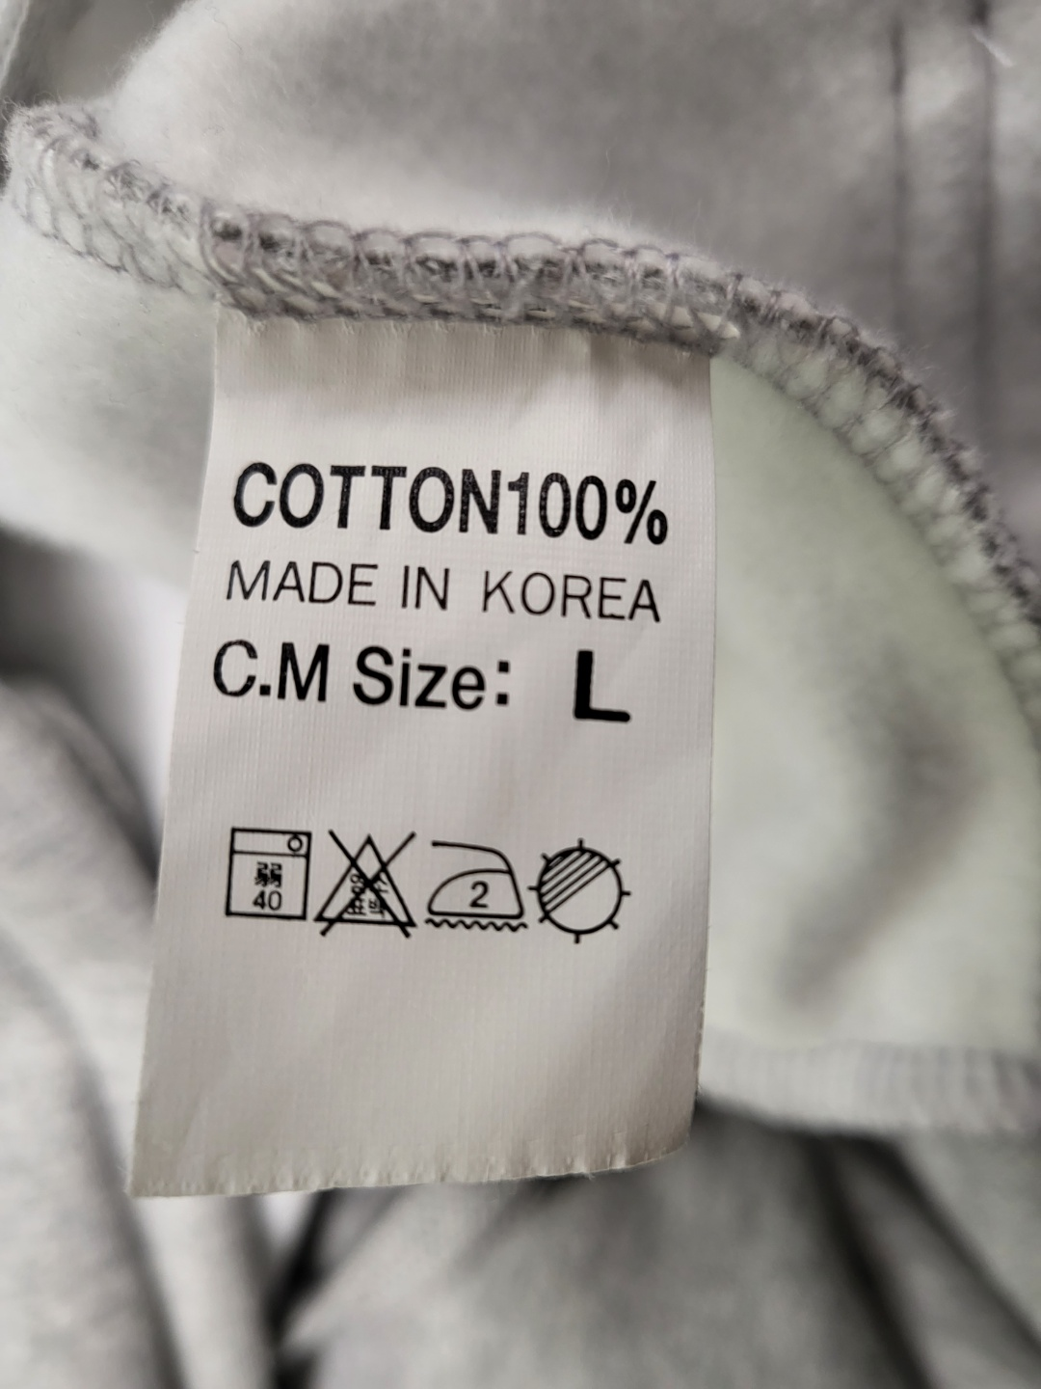

OUR mid project demo
Notes:
This is our short demo video.
We detected the left care labels.

Slide 10
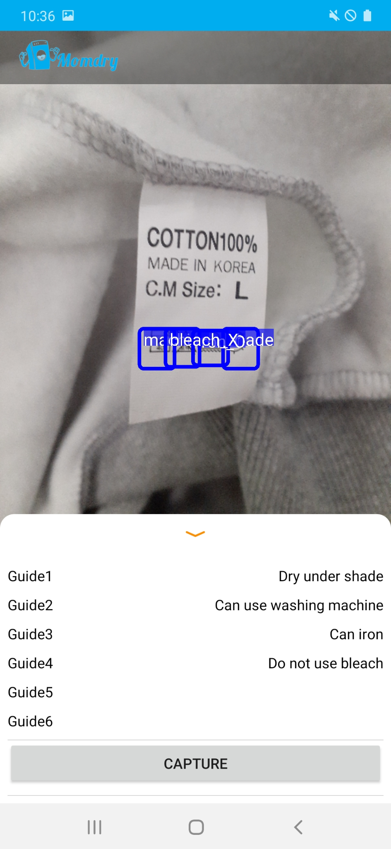
OUR mid project demo
Notes:
The right picture is the screenshot of our app.
When the user click the capture button, the app capture and detect the symbols from the camera.
As you can check from the right picture, the symbol detection was done well and presented the proper guidance for each symbols.

Slide 11
03
System architecture overview

Slide 12
System Architecture
Development Related To Care Label
Input (Camera)
Image from Camera
Label Recognizer
Extract guidance IDs from input image (object detection trained by us)
Guidance DB Manager
Provide stored guide from indexes
Presenters
Print out guide to screen
Image Input
(Camera)
Cloth Selector
Care Label Recognizer
Cloth
Recognizer
Guidance DB Manager
User Cloth DB Manager
Guidance DB
User Cloth DB
Guidance Presenter
Registered List
Presenter
Control Flow
~ Mid. Demo (3, May)
~ Final. Demo (2, June)
Notes:
This is our overall system architecture.
Colored green is what we have done
and White part is that we need to do for the rest of our semester.
first, let’s look at the green part.
As an input, we get image from camera.
and then, washing symbol is detected through our detection model.
That’s the part included in Care Label Recognizer. and Care Label Recognizer also extract guidance IDs from the input image.
next, using that guidance id, we get washing guide from Guidance DB Manager.
and print out the proper washing guide to screen.
those are the things that we have done until may 2nd.
and the rest part.
input is same with the previous one. but we get cloth image.
by using the clothes db manager, we got the cloth id and give specific cloth washing guide.
user also can select the cloth and get laundry information by just click the cloth image.

Slide 13
04
Key technical challenges
&
Solutions

Slide 14
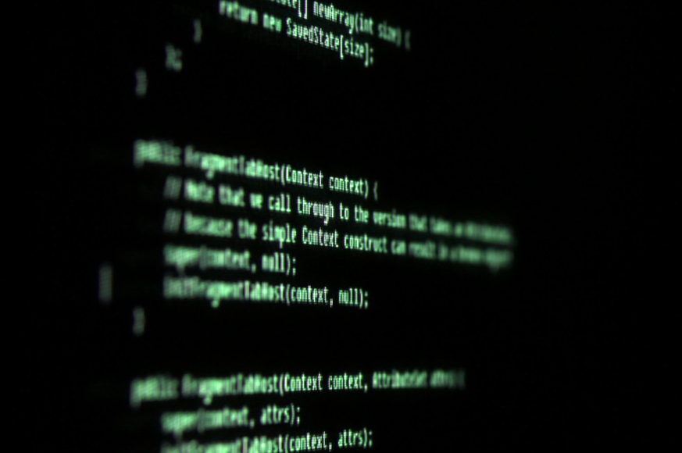

Challenges & Solutions
STEP1. What we were already solved
ALL 4 of us, we are in SYSTEM Lab. (Cheap background in A.I.!!)
There’s a change in our plan
AT FIRST : Classification → Detection
***CHANGE : Detection & Model training
←LOOK AT THIS!!
ALL we’ve seen is just black screen with text only :-o
So we are not familiar with AI, and Application UI design. This is our first time!
Notes:
Classification model + object detection
Challenge: Implemetation difficulty when we tried to build object detection model on classification model
Solution: primarily use object detection model to identify care labels

Slide 15
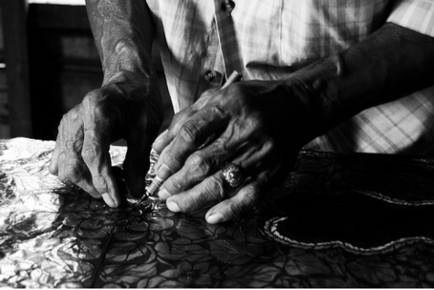
Challenges & Solutions
3. Hard to get care label image
Therefore, we took picture of care label one by one..!
We annotated every washing symbol in care labels and augmented the annotated images
Craftman’s Touch!!!
Notes:
Different washing symbols throughout the country.

Slide 16
Challenges & Solutions
STEP2. What are still needs to be addressed
Object(care label) detecting model
Challenge: lower accuracy than expected
Solution: train the model with more pictures
Continuously runs OD model on back camera
Challenge: detection result might change as camera moves
Solution: modify the implementation to detect model on the picture, not on live camera

Slide 17
05
Project schedule

Slide 18
What we did
Done | JOBS | Mar. ~ 22 (Proposal) | Mar. 23 ~ 31 | Apr. 1 ~ 10 | Apr. 11 ~ 20 | Apr. 21 ~ 30 | May 1 ~ 5 (Milestone 2)
V | Prepare Proposal | JY, DK, IH, MJ
V | Presenter(GUI) module design |  | JY, IH
V | DB manager design |  | DK, MJ
V | Label recognizer module design |  | JY, DK, IH, MJ
V | Presenter implementation |  |  | JY, IH
V | DB manager implementation |  |  | DK, MJ
V | Label recognizer implementation |  |  | JY, DK, IH, MJ | JY, DK, IH, MJ
V | Presenter verification |  |  |  | JY, IH
V | DB manager verification |  |  |  | DK, MJ
V | Integration and test |  |  |  |  | JY, DK, IH, MJ
V | Prepare Mid. Demo |  |  |  |  |  | JY, DK, IH, MJ
Design
(~May 5)
Notes:
Now, I’ll explain our plan.
As we proposed in the first proposal, we implemented and verified functionalities related to care labels.
Two members developed guidance DB and rest of members took charge of GUI.
And care label recognizer is cooperatively developed by all of us.
Although we faced some problems on development of recognizer as described in previous slide, it was valuable time to be familiar with machine learning and Android programming.

Slide 19
Plan until final demo
Done | JOBS | May 6 ~ 10 | May 11 ~ 20 | May 21 ~ 30 | jun 1 ~ 2 (Final demo)
 | Image recognizer module design | JY, DK, IH, MJ
 | Image recognizer implementation |  | JY, DK, IH, MJ
 | Total module integration and verification |  |  | JY, DK, IH, MJ
 | Prepare Final Demo |  |  |  | JY, DK, IH, MJ
Design
(~May 5)
Notes:
From now we’ll develop cloth recognition and link it to existing care label modules.
We didn’t explicitly divide remaining jobs in detail yet, but it is expected to be easier than the prior half of development.

Slide 20
06
Final deliverable and success criteria

Slide 21

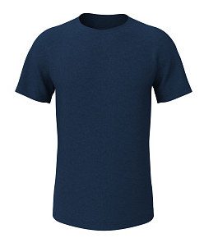
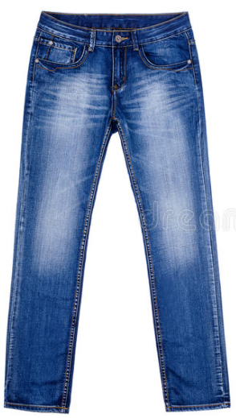
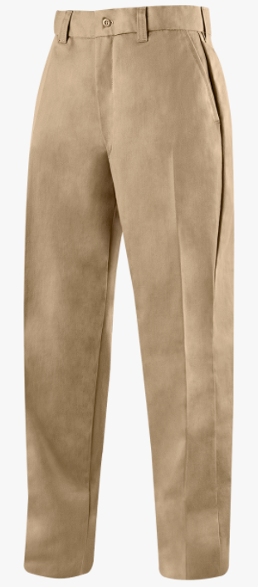




Our Final Solution would be like…
My closet
T-shirt
Click!
WASH SEPARATELY
PROFESSIONAL
DRY CLEAN
RECOMMENDED
Notes:
This is our expected final solution.
Users store their clothes image with corresponding care label images, and Momdry provides proper laundry guidances extracted from the care labels whenever users request.

Slide 22






How to judge?
Mid. Demo | Final Demo
Accuracy
Limited accuracy (More dataset required)
Latency
Human-unrecognizable Latency (Seamless Service)
Durability
Data persistence on shutdown or crash
-
*
* Durability is only required for user data
Notes:
We suggested three metrics to decide successful development of Momdry.
The first was model accuracy.
We couldn’t achieve high accuracy with current version because of not enough care label datasets which should be manually made by us.
Next, Momdry can detect care labels in real-time. We believe that it is acceptable latency.
For durability, it is not evaluable now, because Momdry does not support the store of user information.
We expect that same metrics can be applied to evaluate the final version of Momdry.

Slide 23
07
Q&A
Notes:
This is all we prepared today.
Thank you for listening and please ask any question if you have.

Slide 24
THANK YOU

